Slide 1


Design Pattern - Introduction and Demo with PHP language.
Theories and practice

Slide 2
Knowledge requirements
Proficient in basic programming: functional and procedural programming
Proficient in advanced programming: object-oriented programming

Slide 3
Knowledge overview
What is a Design Pattern?
Where are design patterns applied?
Design Patterns in Programming
Design patterns examples with PHP language

Slide 4
What is a Design Pattern?
In software engineering, a software design pattern is a general, reusable solution to a commonly occurring problem within a given context in software design. It is not a finished design that can be transformed directly into source or machine code. Rather, it is a description or template for how to solve a problem that can be used in many different situations. Design patterns are formalized best practices that the programmer can use to solve common problems when designing an application or system.
https://en.wikipedia.org/wiki/Software_design_pattern

Slide 5



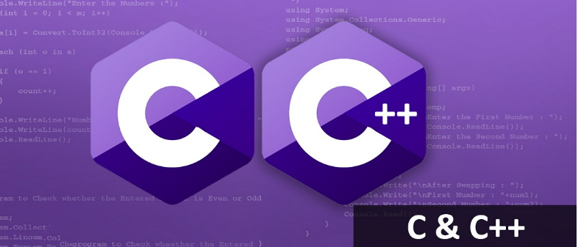
Where are design patterns applied?
Used a lot in libraries or frameworks of programming languages

Slide 6
Design Patterns in Programming
Creational design patterns
Abstract Factory: Creates an instance of several families of classes
Builder: Separates object construction from its representation
Factory Method: Creates an instance of several derived classes
Object Pool: Avoid expensive acquisition and release of resources by recycling objects that are no longer in use
Prototype: A fully initialized instance to be copied or cloned
Singleton: A class of which only a single instance can exist

Slide 7
Design Patterns in Programming
Structural design patterns
Adapter: Match interfaces of different classes
Bridge: Separates an object’s interface from its implementation
Composite: A tree structure of simple and composite objects
Decorator: Add responsibilities to objects dynamically
Facade: A single class that represents an entire subsystem
Flyweight: A fine-grained instance used for efficient sharing
Private Class Data: Restricts accessor/mutator access
Proxy: An object representing another object
Dependency Injection: To implement a loosely coupled architecture in order to get better testable, maintainable and extendable code.

Slide 8
Design Patterns in Programming
Behavioral design patterns
Chain of responsibility: A way of passing a request between a chain of objects
Command: Encapsulate a command request as an object
Interpreter: A way to include language elements in a program
Iterator: Sequentially access the elements of a collection
Mediator: Defines simplified communication between classes
Memento: Capture and restore an object's internal state
Null Object: Designed to act as a default value of an object
Observer: A way of notifying change to a number of classes
State: Alter an object's behavior when its state changes
Strategy: Encapsulates an algorithm inside a class
Template method: Defer the exact steps of an algorithm to a subclass
Visitor: Defines a new operation to a class without change

Slide 9
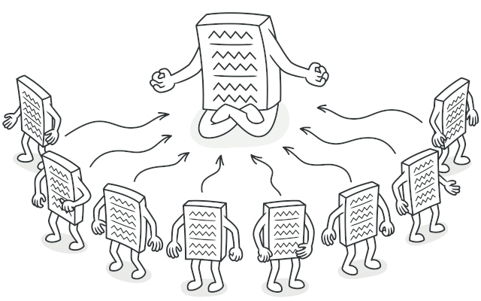
Singleton
Intent
Singleton is a creational design pattern that lets you ensure that a class has only one instance, while providing a global access point to this instance.

Slide 10
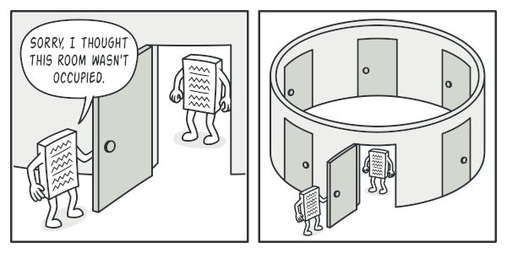
Singleton
Problem : The Singleton pattern solves two problems at the same time, violating the Single Responsibility Principle
Ensure that a class has just a single instance
Provide a global access point to that instance

Slide 11
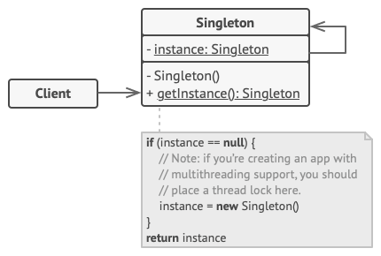
Singleton
Structure
The Singleton class declares the static method getInstance that returns the same instance of its own class
The Singleton’s constructor should be hidden from the client code. Calling the getInstance method should be the only way of getting the Singleton object.

Slide 12
Summary
What is a Design Pattern?
Design Patterns in Programming
Where are design patterns applied?
Thanks you for watching !!!

